Slide 1
Computer Networks

Slide 2
Basics Terms
Data Communication: A process of transferring data(Text , graphics, sound) electronically from one place to another.
Signal: Data transmits through (Electromagnetic / light wave )Signal.
Transmission: Communication of data from one place to another place in the form of signals is called transmission.
Transmission Medium: The transmission medium “carries” the signal Like guided media (Along a physical path e.g. twisted pair, optical fiber )
or unguided media (wireless medium /Means for transmitting electromagnetic waves but not guide them
e.g. air, water, vacuum

Slide 3
Basics Terms
Analogue Signals: Continuous values within some interval e.g. sound, video
Digital Signals: Discrete values e.g. text, integers
Sending device / source or transmitter: Device that send the data e.g. computer ,Fax machine, mobile phone.
Receiving device/sink/Receiver : Device that receive the data

Slide 4
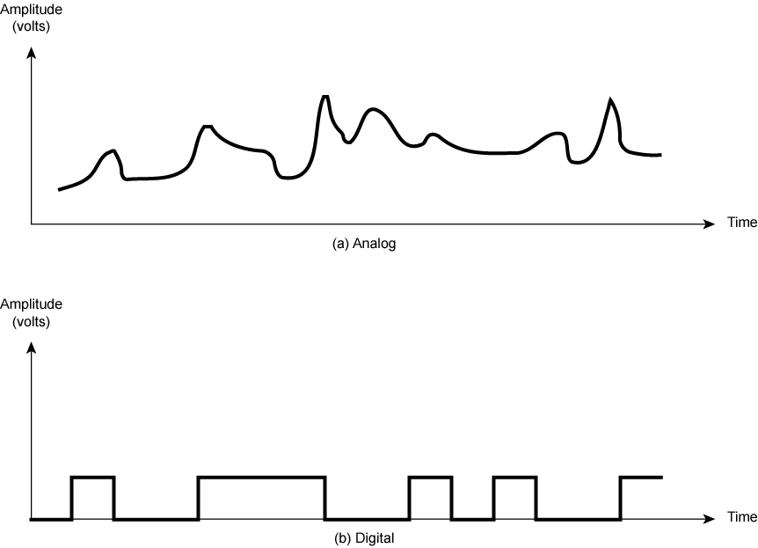
Analogue & Digital Signals
8

Slide 5
Communications
The message (data and information) is communicated via the signal
The transmission medium “carries” the signal
Transmission medium
Sender
Signal
Receiver

Slide 6
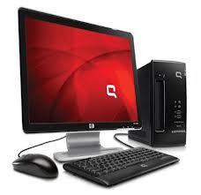
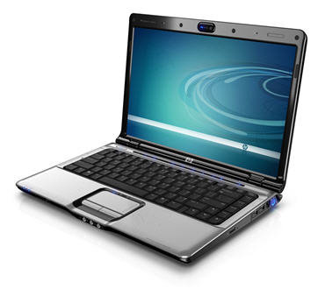
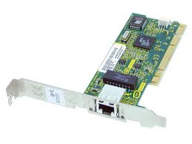
Elements of Data Communication
Receiving Device/sink
Transmission medium /communication channel physical cables or wireless medium “carries” the signal
Message
Message is the info to be communicated.
Sending Device / source or transmitter
Network Card It is used to transmit messages between sending & receiving device through communication medium. It is inserted in each sending & Receiving devises.

Slide 7
Telecommunications
Telecommunications
The electronic transmission of signals for communications, including such means as:
Telephone
Radio
Television
Telecommunication medium
Anything that carries an electronic signal and interfaces between a sending device and a receiving device

Slide 8
Communications and Telecommunications
In human speech, the sender transmits a signal through the transmission medium of the air
In telecommunications, the sender transmits a signal through the transmission medium of a cable

Slide 9
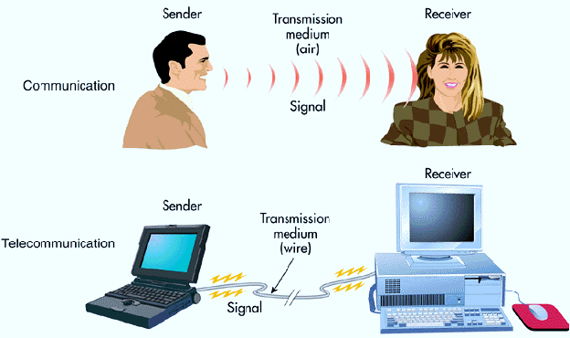

Slide 10
Data Transmission Modes
Simplex mode
Half duplex mode
Full duplex mode

Slide 11
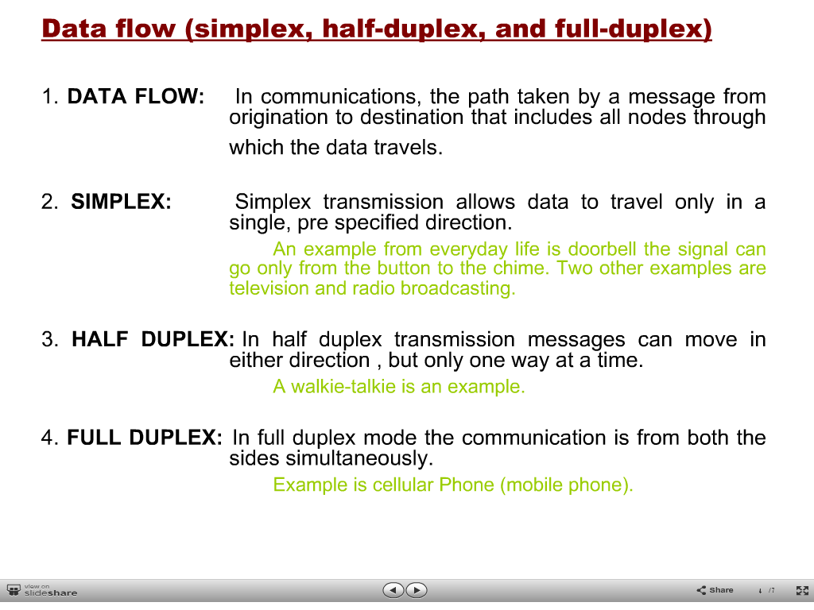

Slide 12
Basics
What is Communication and what is Computer Network?
How many types of networks exist?
What distinguishes a Computer Network from other Networks?
What a Computer Network is and why we need it?

Slide 13
What is a Computer Network?
A network consists of two or more computers that are linked in order to share resources (such as printer, scanners, etc.), exchange files, or allow electronic communications.
Examples of computer network
used in office
Internet

Slide 14
Basics
Communication is a way that how devices, equipment will communicate to each other in such a way that they can understand each other.
Computer Networking is the way that how are you going to interconnect different devices/equipment
Telephone network, Cable TV network, …
Not specific to a particular application but generic and supports a wide range of applications (General purpose programmable hardware)

Slide 15
HOP
A hop is a computer networking term that refers to the number of routers that a packet (a portion of data) passes through from its source to its destination. Sometimes a hop is counted when a packet passes through other hardware on a network, like switches, access points, and repeaters

Slide 16

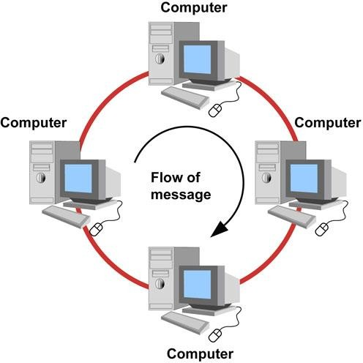
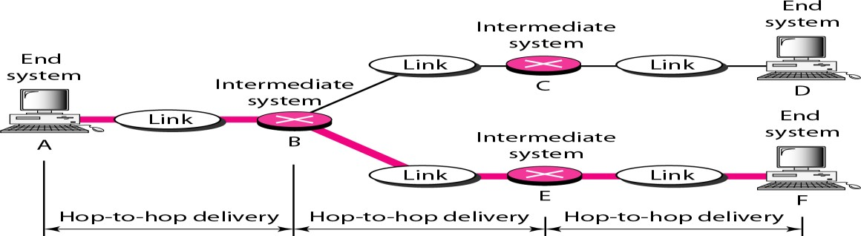
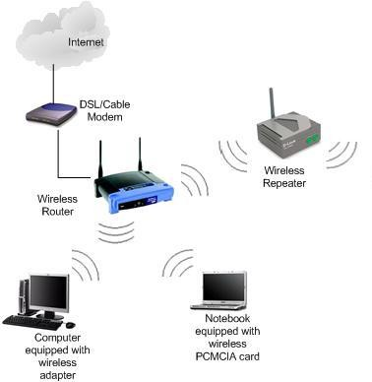
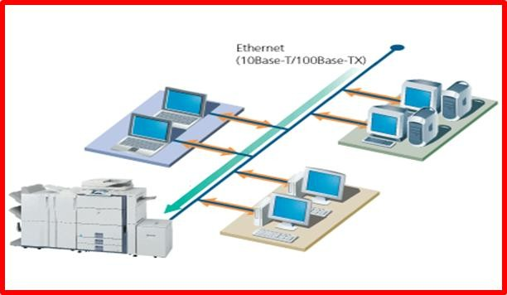
What a Computer Network is?
Set of connected autonomous computers (having programmable hardware)
Hop

Slide 17
Need of Computer Network
For Cost-effective Resource Sharing (files, printers, modems, fax machines)
For application software Sharing (Like MS Office)
Increase productivity (make it easier to share data amongst users)
For Information Sharing
Ease in Communication

Slide 18
Applications of Communication & Computer Network
Computer systems and peripherals are connected to form a network. They provide numerous advantages:
Resource sharing such as printers and storage devices
Exchange of information by means of e-Mails and FTP
Information sharing by using Web or Internet
Interaction with other users using dynamic web pages
IP phones
Video conferences
Parallel computing
Instant messaging

Slide 19
Network Components
Server:
Powerful computer that provides services to the other computers on the network .
Service provided by the server
Control access to the hardware ,software and data
Centralized storage for software ,data & information
Processing data
Sharing software
Managing network traffic
Dedicated Server
Perform one specific task that require a lot of timee.g handling e-mail
Proxy Server
File sharing server
Print Sharing Server
Client:
Computer that uses the services that a server provides. The client usually less powerful than the server,

Slide 20
Network Components
Peer:
A computer that acts as both a client and a server.
Media:
Physical connection between the devices on a network.
Resources:
Anything available to a client on a network is considered a resource. Printers, data, fax devices, and other networked devices and information are resources.
User:
Any person that uses a client to access resources on the network.
Protocol:
Protocols are written rules used for communications. They are the languages that computers use to talk to each other over a network.

Slide 21
Advantages of networking
Share of resources:
Economical benefits
Multiple Access
Centralized Management
Mail/Email/Message
Conferencing /Assistance
Technology and expertise sharing
Connectivity and Communication :
Network connects the computers and users of those computers. Network users can communicate with each other using technologies such as email……
Information & resource Sharing:
Data and information can be shared among different users . Resources like Printers , Scanners , CD-ROM drives , hard disks an software can be shared.

Slide 22
Advantages of networking
Money saving:
By using same software over the network.
Internet Access Sharing :
Single internet connection/multiple users
Data Security and Management :
A network can manage the company’s critical data in a better way. Data can be centralized on shared server. data can be easily find.it is easier for the administrator to take the backup of data regularly. security can be implemented.
Entertainment :
Games facility

Slide 23
The Disadvantages (Costs) of Networking
Network Hardware, Software and Setup Costs :
Setting up a network requires an investment in hardware, software , planning, designing and implementing the network.
Hardware and Software Management and Costs
Managing a network is complicated .It requires training. A network manager usually needs to be employed .In big organization , a network administrator is hired.
Data Security Concerns :
A poorly-secured network puts critical data at risk. It may expose data to hackers, unauthorized access .

Slide 24


Slide 25
LECTURE 2

Slide 26
Classification of Computer Networks
Computer networks are classified based on various factors. They includes:
Geographical span
Inter-connectivity
Administration
Architecture

Slide 27
Classification of Computer Networks
1:Geographical Span
LAN
MAN
WAN

Slide 28
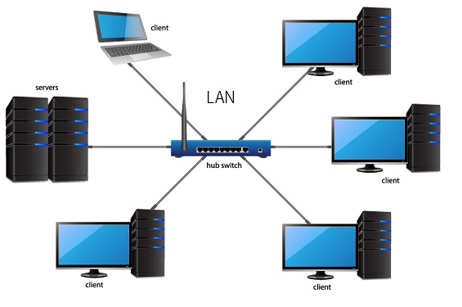
Classification of Computer Networks
Local Area Network:

Slide 29
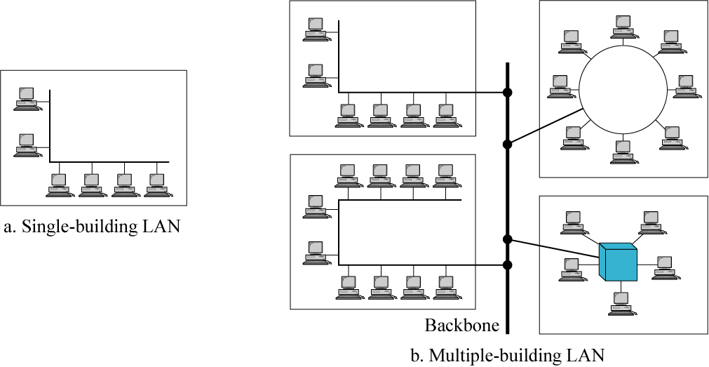
LAN
Prepared by Mata ur Rahman

Slide 30
Classification of Computer Networks
Local Area Networks (LANs):
Small network, short distance
A room, a floor, a building
Limited by no. of computers and distance covered ( 1km)
Data transmission speed is 1 to 100 mbps
Usually one kind of technology throughout the LAN
Serve a department within an organization
Ethernet is most common for pcs
Examples:
Network inside the Student Computer Room
Network inside your home

Slide 31
Classification of Computer Networks
Local Area Network:
LAN or Local Area Network connects network devices in such a way that personal computer and workstations can share data, tools and programs. The group of computers and devices are connected together by a switch, or stack of switches, using a private addressing scheme as defined by the TCP/IP protocol. Private addresses are unique in relation to other computers on the local network. Routers are found at the boundary of a LAN, connecting them to the larger WAN.

Slide 32
Classification of Computer Networks
Local Area Network:
Data transmits at a very fast rate as the number of computers linked are limited. By definition, the connections must be high speed and relatively inexpensive hardware (Such as hubs, network adapters and Ethernet cables). LANs cover smaller geographical area (Size is limited to a few kilometers) and are privately owned. One can use it for an office building, home, hospital, schools, etc. LAN is easy to design and maintain. A Communication medium used for LAN has twisted pair cables and coaxial cables. It covers a short distance, and so the error and noise are minimized.

Slide 33
Classification of Computer Networks
Local Area Network:
Early LAN’s had data rates in the 4 to 16 Mbps range. Today, speeds are normally 100 or 1000 Mbps. Propagation delay is very short in a LAN. The smallest LAN may only use two computers, while larger LANs can accommodate thousands of computers. A LAN typically relies mostly on wired connections for increased speed and security, but wireless connections can also be part of a LAN. The fault tolerance of a LAN is more and there is less congestion in this network. For example : A bunch of students playing Counter Strike in the same room (without internet).

Slide 34
Propagation delay:
It is amount of time which is taken by the first bit (head of the signal) to travel form the sender to the receiver. In other words it is simply time required for the bits to reach the destination from the start point. Factors on which propagation delay depends are Distance and propagation speed.
Propagation delay = distance /transmission speed =d/s
d is distance and s is the wave propagation speed.

Slide 35
Fault Tolerance:
Fault tolerance is the ability of a system (computer ,network, cloud cluster ) to continue operating without interruption when one or more of its components fail.
Fault tolerant system uses the backup components that automatically take the place of failed component , ensuring no loss of service. these include Hardware systems, software systems power sources.

Slide 36
Congestion:
Congestion is the reduced of quality of service that occurs when a network node or link is carrying more data than it can handle .typical effects include queuing delay , packet loss or the blocking of new connection.

Slide 37
Classification of Computer Networks
Advantages of LAN
Resource sharing : Computer resources like hard-disks, DVD-ROM, and printers can share local area networks. This significantly reduces the cost of hardware purchases.
Communication :You can easily transfer data and messages over networked computers.
Application sharing :You can use the same software over the network instead of purchasing the licensed software for each client in the network.
Centralized data :Data of all network users can be stored on a single hard disk of the server computer.
Data security and management :It will be easy to manage data at only one place, which makes data more secure.
Internet access sharing :Local Area Network offers the facility to share a single internet connection among all the LAN users.
Centralized I.T administration:

Slide 38
Classification of Computer Networks
Disadvantages of LAN
LAN will indeed save cost because of shared computer resources, but the initial cost of installing Local Area Networks is quite high.
The LAN admin can check personal data files of every LAN user, so it does not offer good privacy.
Unauthorized users can access critical data of an organization in case LAN admin is not able to secure centralized data repository.
Local Area Network requires a constant LAN administration as there are issues related to software setup and hardware failures

Slide 39
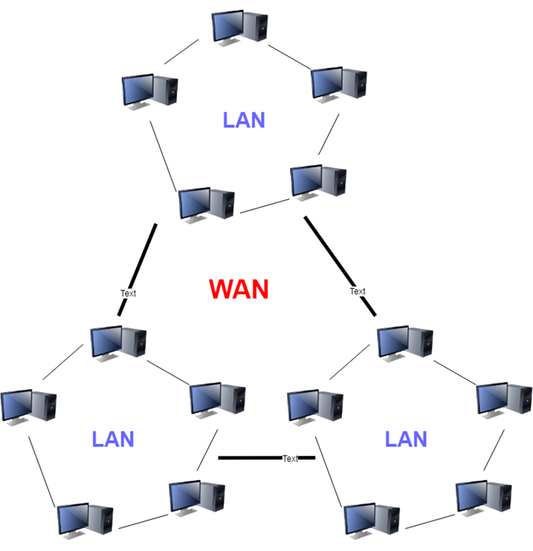
Classification of Computer Networks
Wide Area Network (WAN)

Slide 40
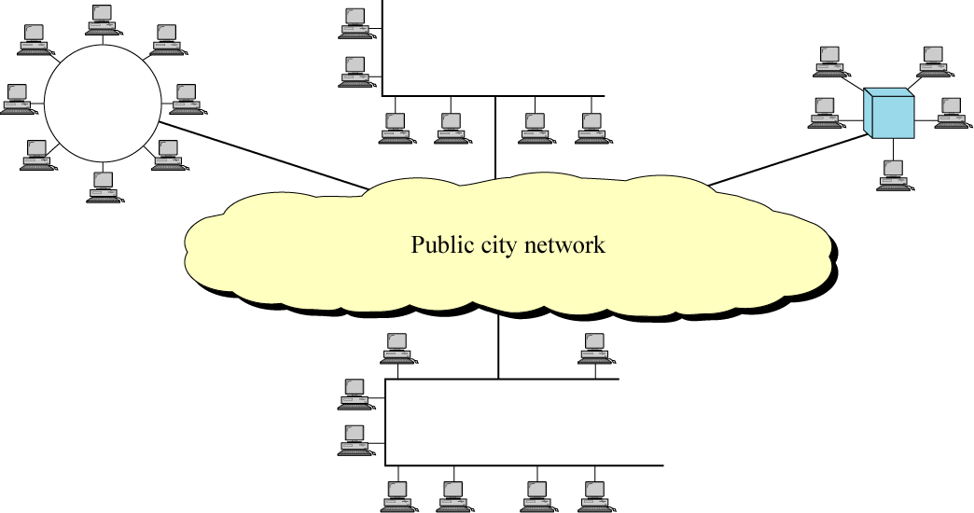
MAN

Slide 41
Classification of Computer Networks
Wide Area Network (WAN)
WAN or Wide Area Network is a computer network that extends over a large geographical area, although it might be confined within the bounds of a state or country. A WAN could be a connection of LAN connecting to other LAN’s via telephone lines and radio waves and may be limited to an enterprise (a corporation or an organization) or accessible to the public. The technology is high speed and relatively expensive.

Slide 42
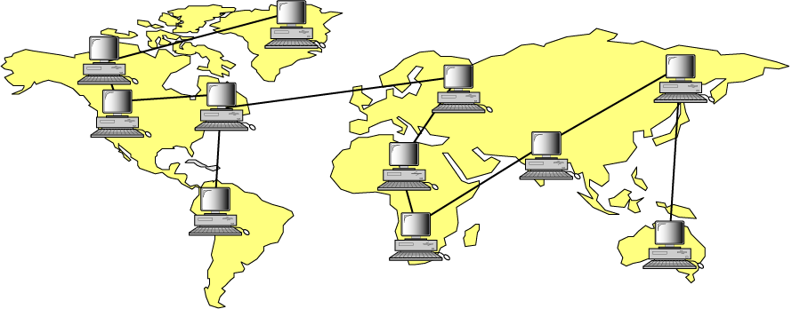
WAN
Prepared by Mata ur Rahman

Slide 43
Classification of Computer Networks
There are two types of WAN:
Switched WAN and Point-to-Point WAN.
WAN is difficult to design and maintain. Similar to a MAN, the fault tolerance of a WAN is less and there is more congestion in the network.
A Communication medium used for WAN is PSTN or Satellite Link. Due to long distance transmission, the noise and error tend to be more in WAN.

Slide 44
Classification of Computer Networks
WAN’s data rate is slow about a 10th LAN’s speed, since it involves increased distance and increased number of servers and terminals etc. Speeds of WAN ranges from few kilobits per second (Kbps) to megabits per second (Mbps). Propagation delay is one of the biggest problems faced here. Devices used for transmission of data through WAN are: Optic wires, Microwaves and Satellites. Example of a Switched WAN is the asynchronous transfer mode (ATM) network and Point-to-Point WAN is dial-up line that connects a home computer to the Internet.

Slide 45
Classification of Computer Networks
Advantages of WAN
WAN helps you to cover a larger geographical area. Therefore business offices situated at longer distances can easily communicate.
Contains devices like mobile phones, laptop, tablet, computers, gaming consoles, etc.
WLAN connections work using radio transmitters and receivers built into client devices.

Slide 46
Classification of Computer Networks
Disadvantage of WAN
The initial setup cost of investment is very high.
It is difficult to maintain the WAN network. You need skilled technicians and network administrators.
There are more errors and issues because of the wide coverage and the use of different technologies.
It requires more time to resolve issues because of the involvement of multiple wired and wireless technologies.
Offers lower security compared to other types of networks.

Slide 47
Classification of Computer Networks
Metropolitan Area Network (MAN)
MAN or Metropolitan area Network covers a larger area than that of a LAN and smaller area as compared to WAN. It connects two or more computers that are apart but resides in the same or different cities. It covers a large geographical area and may serve as an ISP (Internet Service Provider). MAN is designed for customers who need a high-speed connectivity. Speeds of MAN ranges in terms of Mbps. It’s hard to design and maintain a Metropolitan Area Network. It serves 5 to 50 kilometers area in range.

Slide 48
Classification of Computer Networks
Metropolitan Area Network :
The fault tolerance of a MAN is less and also there is more congestion in the network. It is costly and may or may not be owned by a single organization. The data transfer rate and the propagation delay of MAN is moderate. Devices used for transmission of data through MAN are: Modem and Wire/Cable. Examples of a MAN are the part of the telephone company network that can provide a high-speed DSL line to the customer or the cable TV network in a city.

Slide 49
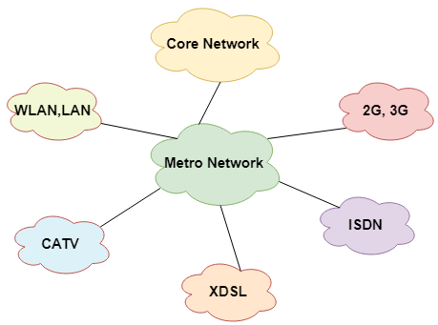
Classification of Computer Networks

Slide 50
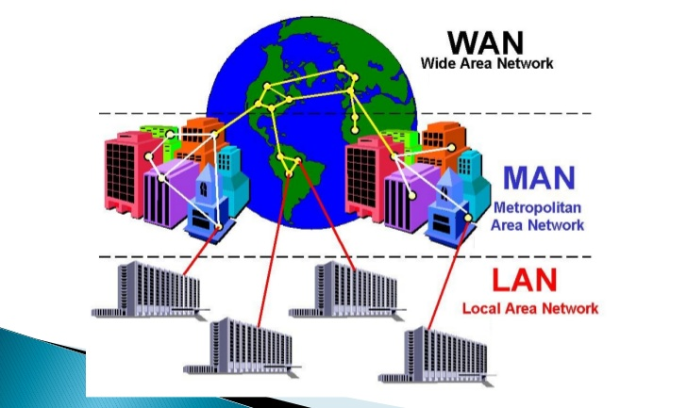

Slide 51
Advantages of MAN
Here are pros/benefits of using MAN system:
It offers fast communication using high-speed carriers, like fiber optic cables.
It provides excellent support for an extensive size network and greater access to WANs.
The dual bus in MAN network provides support to transmit data in both directions concurrently.
A MAN network mostly includes some areas of a city or an entire city.

Slide 52
Classification of Computer Networks
Disadvantages of MAN
Here are drawbacks/ cons of using the MAN network:
You need more cable to establish MAN connection from one place to another.
In MAN network it is tough to make the system secure from hackers

Slide 53
2: Inter-Connectivity
Components of a network can be connected to each other differently in some fashion. By connectedness we mean either logically , physically , or both ways.
logically connected
Physically connected

Slide 54
2: Inter-Connectivity
Every single device can be connected to every other device on network, making the network mesh.
All devices can be connected to a single medium but geographically disconnected, created bus like structure.
Each device is connected to its left and right peers only, creating linear structure.
All devices connected together with a single device, creating star like structure.
All devices connected arbitrarily using all previous ways to connect each other, resulting in a hybrid structure.

Slide 55
Classification of Computer Networks
3:Administration
From an administrator’s point of view, a network can be private network which belongs a single autonomous system and cannot be accessed outside its physical or logical domain. A network can be public which is accessed by all.

Slide 56
Classification of Computer Networks
4:Network Architecture
Computer networks can be discriminated into various types such as Client-Server, peer-to-peer or hybrid, depending upon its architecture.
There can be one or more systems acting as Server. Other being Client, requests the Server to serve requests. Server takes and processes request on behalf of Clients.
Two systems can be connected Point-to-Point, or in back-to-back fashion. They both reside at the same level and called peers.
There can be hybrid network which involves network architecture of both the above types.

